Slide 1

Introduction to Big Data and Hadoop Ecosystem
Big Data refers to massive, fast-growing datasets from diverse sources. Traditional systems often struggle to efficiently store and process this volume of information. Hadoop, an open-source Java framework, provides a scalable and cost-effective solution for distributed storage and processing of Big Data on commodity hardware.

Slide 2
Overview of Big Data and Hadoop
1
2
Google Roots
Yahoo's Contribution
Hadoop originated from Google's File System and MapReduce concepts in 2003, designed for large-scale data processing.
Yahoo open-sourced Hadoop in 2008, naming it after the creator's son's toy elephant, making it widely accessible.
3
4
Core Modules
Petabyte Scale
Key components include HDFS (storage), YARN (resource management), MapReduce (processing), and Hadoop Common (utilities).
Hadoop efficiently handles structured, semi-structured, and unstructured data, scaling to petabytes of information.

Slide 3


Pop Quiz: Hadoop Basics
What programming language is Hadoop primarily based on?
Name the four main Hadoop modules.
What is the primary storage component of Hadoop?
True or False: Hadoop requires expensive, specialized hardware.

Slide 4
Hadoop Ecosystem Components
1
2
HDFS
YARN
Distributed file system for storing data across nodes with built-in fault tolerance.
Resource manager responsible for scheduling and allocating cluster resources efficiently.
3
4
MapReduce
Hadoop Common
A programming model for processing large datasets with a parallel, distributed algorithm.
Provides shared utilities and libraries supporting other Hadoop modules.
Additional powerful tools like Hive, Pig, HBase, Spark, Presto, and Zeppelin extend Hadoop's capabilities for diverse big data tasks.

Slide 5
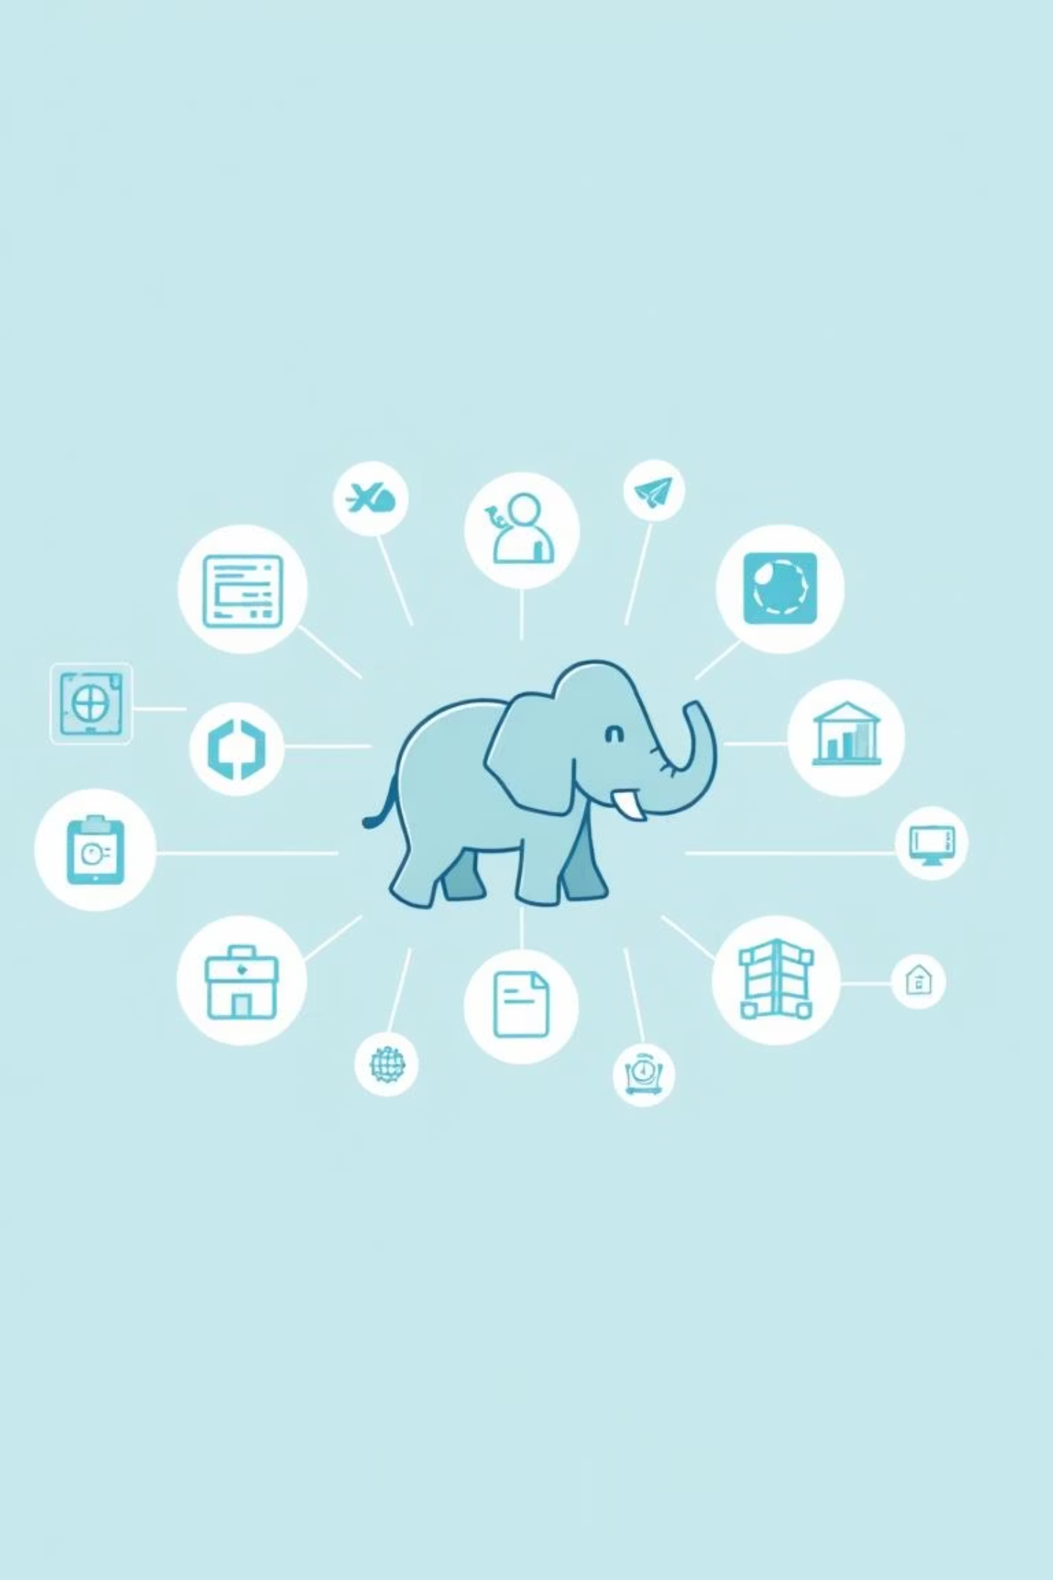
Quiz: Hadoop Ecosystem Tools
Which component manages compute resources? (YARN)
Which tool provides SQL-like querying for Hadoop? (Hive)
What is Apache Spark primarily used for? (Fast in-memory data processing)
Name a NoSQL database commonly used within the Hadoop ecosystem. (HBase)

Slide 6




Key Takeaways
Distributed Processing
Hadoop enables distributed and parallel processing of massive Big Data datasets.
Scalable Infrastructure
It scales efficiently from a single server to thousands of commodity machines.
Fault Tolerant
Hadoop automatically handles hardware failures, ensuring data integrity and availability.
Diverse Analytics
It supports various data types and large-scale analytics workloads for deep insights.

Slide 7
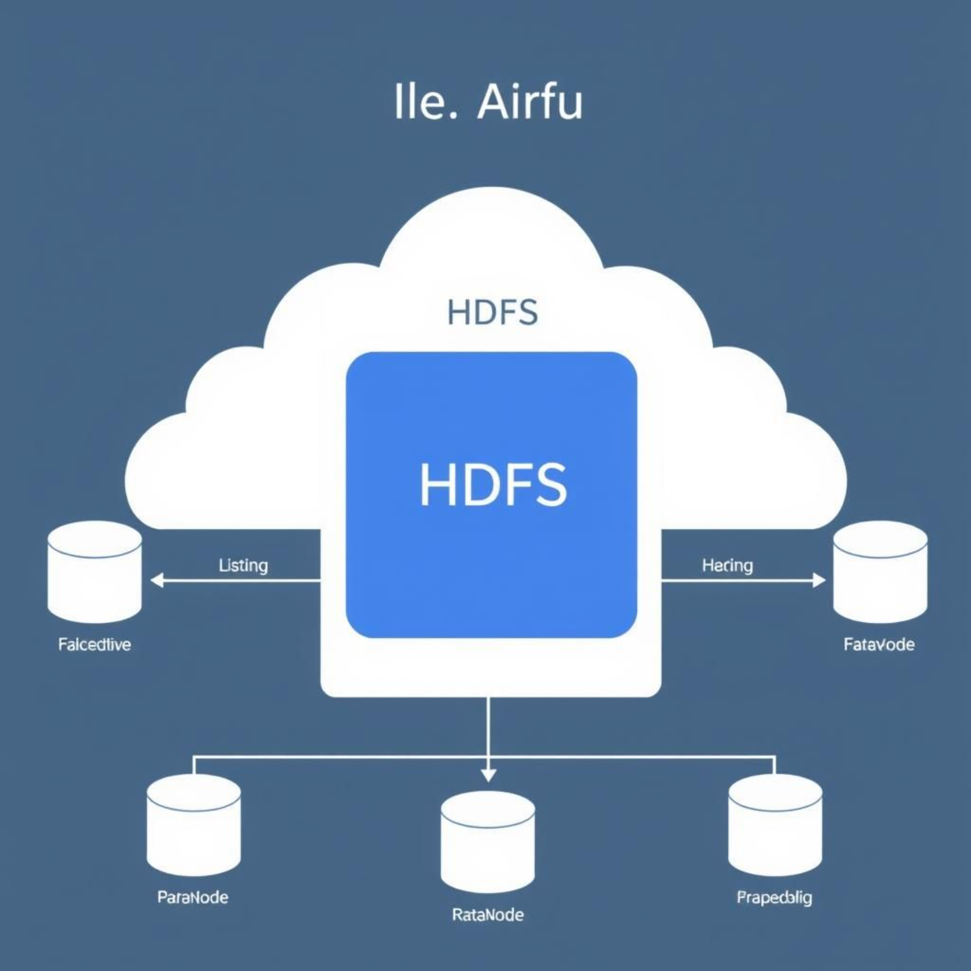
Introduction to HDFS Architecture and Components
HDFS (Hadoop Distributed File System) is designed for reliable storage of very large files across machines in a cluster.
Data Blocks: HDFS stores data in default 128MB blocks, distributed across multiple DataNodes.
NameNode: The master node manages the file system namespace and metadata (e.g., file permissions, block locations).
DataNodes: Worker nodes that store the actual data blocks and perform read/write operations.
Secondary NameNode: Performs checkpointing of NameNode metadata, preventing data loss in case of a NameNode failure.
Data Replication: By default, HDFS maintains 3 copies of each data block, ensuring high availability and fault tolerance.

Slide 8
Summary and Next Steps
Hadoop Foundation: It is a cornerstone for modern Big Data processing, enabling efficient handling of massive datasets.
Ecosystem Power: A rich ecosystem of tools extends Hadoop’s capabilities for advanced analytics and diverse storage needs.
HDFS Mastery: Understanding HDFS architecture is crucial for effective data management and reliability within Hadoop.
Next: Our next session will deep dive into YARN for resource management and MapReduce for understanding job execution and parallel processing.

